Slide 1
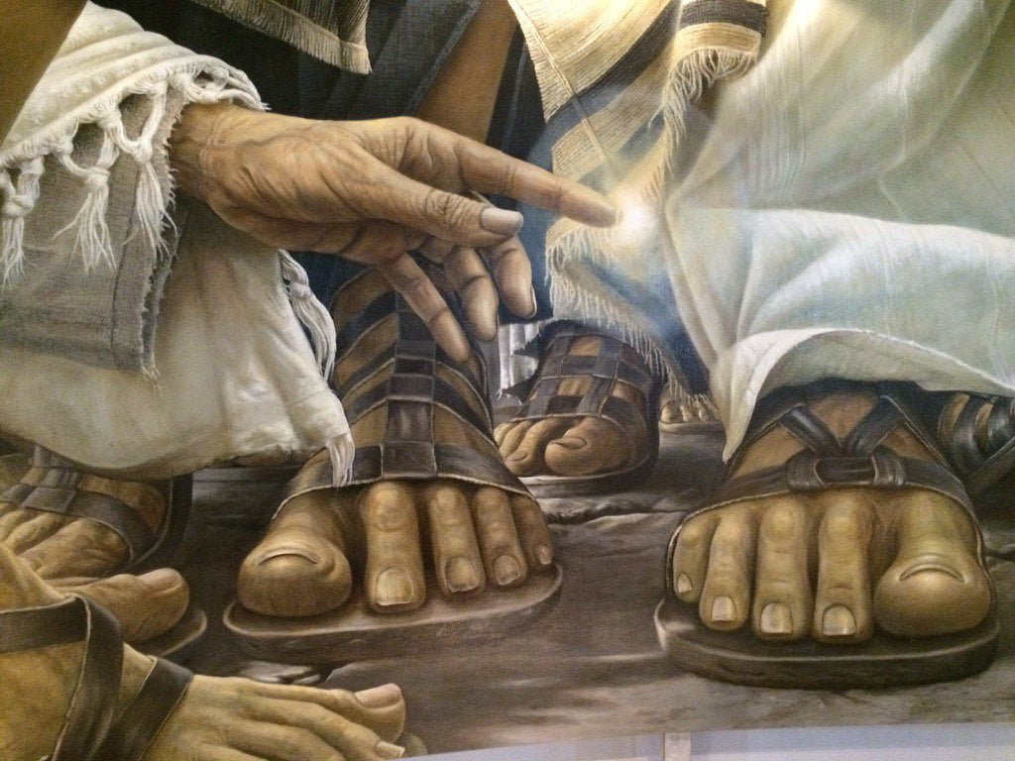
Healing in the
Old Testament
Dr. Rick Griffith • Jordan Evangelical Theological Seminary • BibleStudyDownloads.org

Slide 2
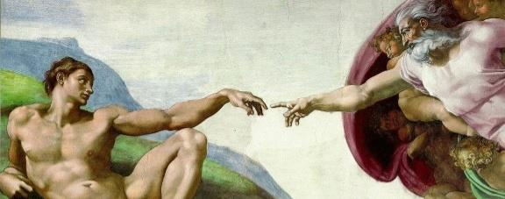
Introduction
God created man in His image
Made man to rule
God made men healthy

Slide 3

If God is good and all powerful, then why is there sickness and pain?
God’s love gave us freedom & choice
Man rebelled at the Fall
God loved us & pursued us back.
God loved us
in man’s original state

Slide 4
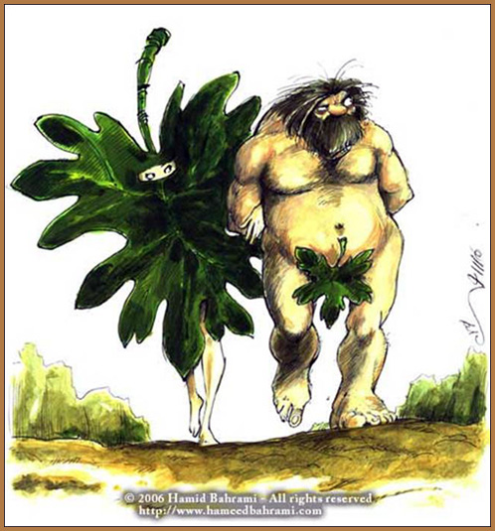
Result of the fall

Slide 5
Results of the Fall
Pain/Sickness & toil
Fall
Separation & death
Broken relationship

Slide 6
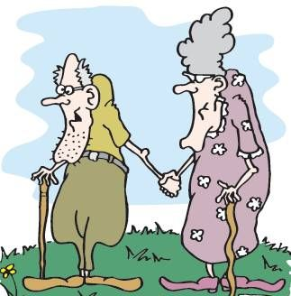
Understanding sickness in the OT
Old age Eccl 12:1-7
Weakness
Poor eyesight
Loss of hearing
Loss of teeth
Insomnia
Loss of desires
Increased fear

Slide 7
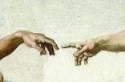
God inflicts and He heals
Deut. 32:39
I kill and I make alive; I wound and I heal
1 Sam. 2:6
The LORD kills and brings to life; he brings down to Sheol and raises up.
Hos. 6:1 Come, let us return to the LORD; for he has torn us, that he may heal us; he has struck us down, and he will bind us up.

Slide 8
Warnings for Disobedience in Deut. 28
Barren womb
Inflam-mation
Fever
Itch
Madness
Pestilence
Wasting disease
Boils
Tumours
Scabs
Blindness
Confusion
Sores everywhere
Sickness not known

Slide 9
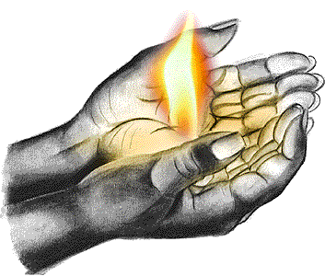
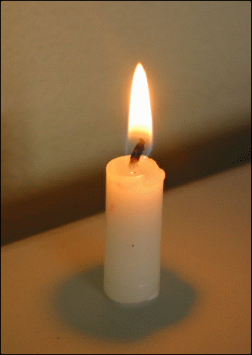
Like the heat from the fire that warns us of the danger of the flame, sickness warns us of the effects of sin and eternal death.

Slide 10
Plagues as punishment for sins
Worship of Golden Calf (Exod.32:34)
Refusal to enter promised land (Num. 14:37)
Grumbling against God for lack of food (Num. 11:31-33)
Plague of snakes for grumbling against the Lord (Num.21:8-9)
Rebellion of Korah (Num. 16:47-50)

Slide 11
David’s pride in the census (2 Sam. 24:15)
King Jeroboam’s idolatry
(1 Kings 12:25-33)
In reply to King Zedekiah’s reign hoping that God will deliver (Jer. 21:7).
Worship at Peor with sexual sins
(Num. 25:1-9)

Slide 12
Sickness on individuals
Er and Onan struck dead (Gen 38:6-8)
Uzzah struck dead for touching the Ark (2 Sam. 6:7)
Miriam was struck with leprosy for rebellion (Num. 12:9-16)
Nabal’s heart attack for his insolence towards David (1 Sam. 25:37)

Slide 13
King Uzziah was struck with leprosy for offering incense (2 Kings 15:5)
David’s loss of first child for adultery (2 Sam. 12:14)
Gehazi was struck with leprosy for his greed (2 Kings 5:26-27)
David’s wife Michal became barren
(2 Sam. 6:23)

Slide 14
King Jeroboam’s hand withered for wanting to imprison a prophet of the Lord (1 Kings 13:4)
King Ahaziah consulted Baal Zebub and not the Lord, so he died from his injuries from a fall (2 Kings 1:1-17)
King Jehoram was struck with incurable disease of the bowels by the Lord (2 Chr. 21:18-19)
King Asa relied on an alliance with Syria rather than God, so God struck him with a disease from head to foot, from which he died (2 Chr. 16:12)

Slide 15
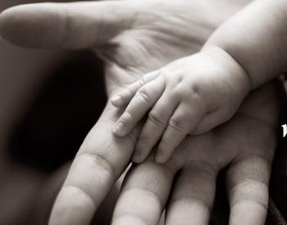
It was out of God’s love that sickness came about. This was so we may see the consequences of sin, draw away from sin and towards God.

Slide 16
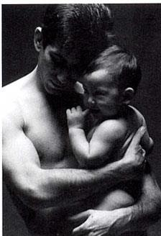

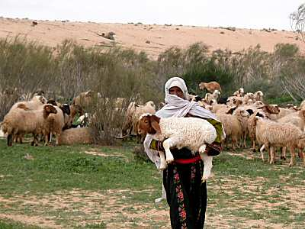
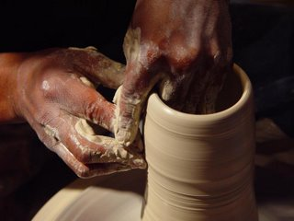
God depicts his relationship between God and His people in various ways

Slide 17
Sickness protected God’s people
God sent a plague on Egypt to protect Abraham and Sarah (Gen. 12:17)
Closing the wombs of Abimelech’s household protected Sarah (Gen. 20:17)
Jacob became lame to remind him that he needed to rely on God (Gen. 32:32)
10 plagues on Egypt displayed God’s salvation (Exod. 5-13)
God gave the Philistines tumors so they would return the ark (1 Sam. 5:6-12)

Slide 18
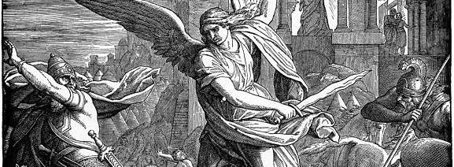
God delivered Israel from the Assyrian army by striking many of them dead (2 Chr. 32:21)
King Abijah died from sickness so as to be spared from violent death (1 Kings 14:10-13)

Slide 19
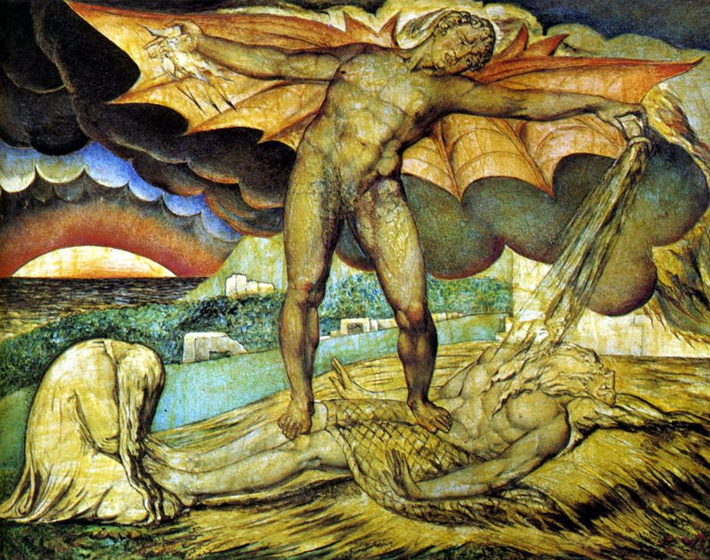
The adversary as responsible for sickness in Job

Slide 20
Understanding Health in OT
GOD
Shalom
Body
Soul
Spirit
Love
Deut. 6:5 You shall love the LORD your God with all your heart and with all your soul and with all your might.

Slide 21

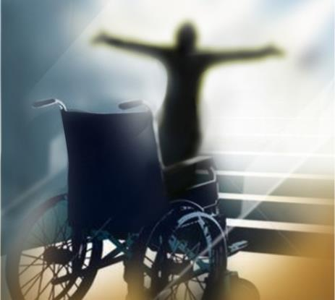
2 Types of Healing
Natural
Supernatural

Slide 22
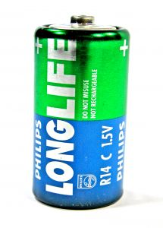
God’s Promise of Health
Exod. 23:25-26; Deut. 7:12-13; 28:4
Abraham told he would die in shalom --peace, fullness of life (Gen. 15:15)
Psalm 91-- God will satisfy them with long life and salvation (yeshua)
Isa. 46:4-- God promised to take care of men even when they are old

Slide 23
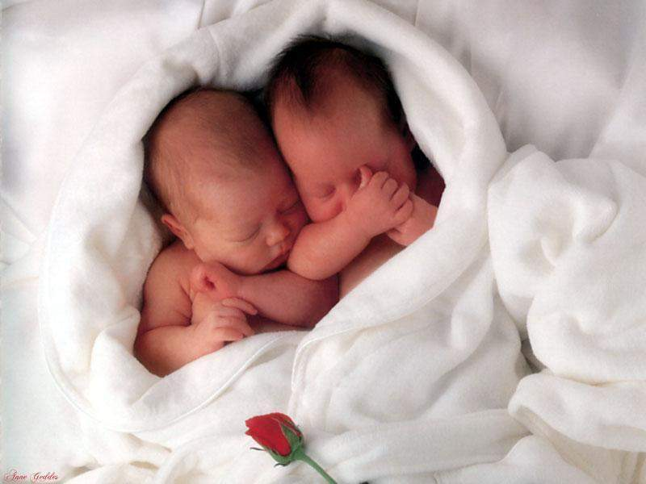
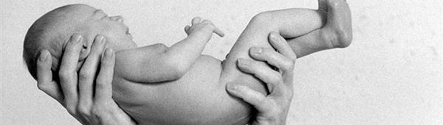
God’s Promise of Fertility
The first sickness and healing: Sarah’s fertility (Gen. 1:28; 11:30)
Manoah’s wife gave birth to Samson (Judg. 13:2) and Hannah gave birth to Samuel (1 Sam. 2:5)
Healed of barrenness: Sarah (Gen. 21:1), Rebekah (Gen. 25:21) and Rachel (Gen. 30:22)

Slide 24
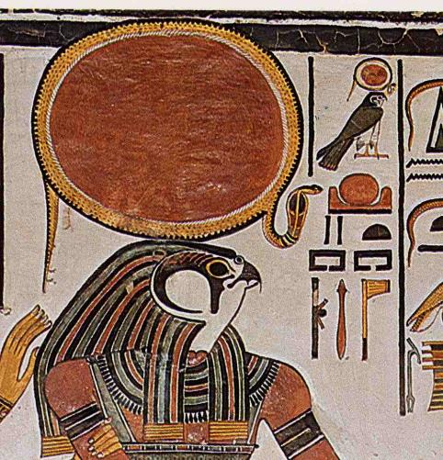
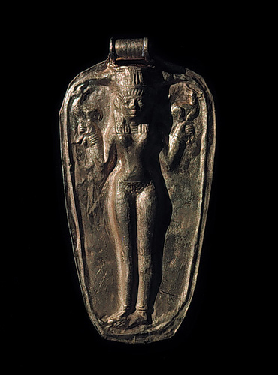
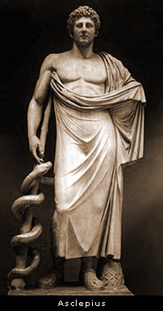
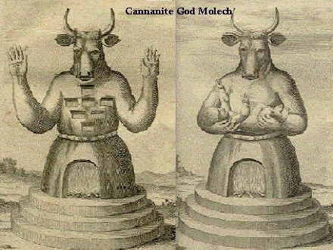
AGENTS OF HEALING IN THE OT
Gods of Israel’s surrounding nations

Slide 25
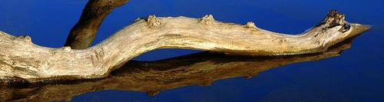
Jehovah Rapha who heals
Exod. 15:26 saying, “If you will diligently listen to the voice of the LORD your God, and do that which is right in his eyes, and give ear to his commandments and keep all his statutes, I will put none of the diseases on you that I put on the Egyptians, for I am the LORD, your healer.”

Slide 26
Agents of Healing
Priest - custodians of the law
Physicians - but not of significance status
Public health rules
Persons suspected of contagious disease quarantined
Made sacrifices and atoned for one who sinned
Prophets - draw men back to God
Guidance led the person to acts of supernatural healing
Proclamation – declare either healing or death

Slide 27
Obedience and healing
Rest
Sanitation
Sterilization
Quarantine
Hygiene
Physical Culture
Public Health

Slide 28
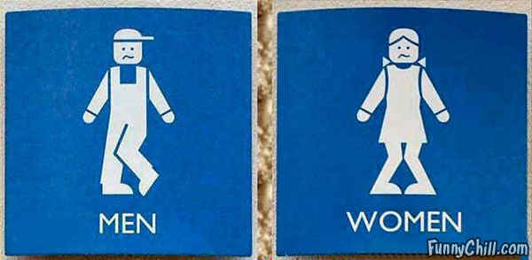
Sanitation
MEN
WOMEN

Slide 29
Sanitation
The flesh, skin and the dung of the sacrifices were burnt outside the camp
They buried excrement outside the camp
Quarantine/ Sterilization
If they touched anything unclean, be they corpses or diseased, they were to wash themselves.
If suspect of infectious diseases, the subjects were to be quarantined outside the camp
Notes:
For sanitation, the flesh, skin and the dung of the sacrifices was to be burnt outside the camp (Exod. 29:14; Lev. 4:14; Lev. 8:17; Lev. 16:27; Num. 19:5).²⁹ The people were also commanded to bring their excrement outside the camp and bury them (Deut. 23:12-13).³⁰
Quarantined When Israelites touched anything unclean, be it corpses or diseased, they were to wash themselves. Any containers that came in contact with uncleanness were to be broken or washed (Lev. 11:25; Lev. 11:32-33, 39, 40; Num. 19:11; Num.31:22-23).³¹ When there was suspect of infectious disease, the subjects were to be quarantined outside the camp (Num. 5:4; Lev. 13-14).³²

Slide 30
Hygiene
No blood / fat
No eating scavenger animals
Physical Culture
Stay 2 weeks in a tent during feast of tabernacles
Present themselves three times a year
Circumcised on the 8th day
Forbidden from ritualistic sex
Work six days a week
Sabbath
Each week they had one day rest
Sabbatical year (year of rest), Jubilee Year

Slide 31
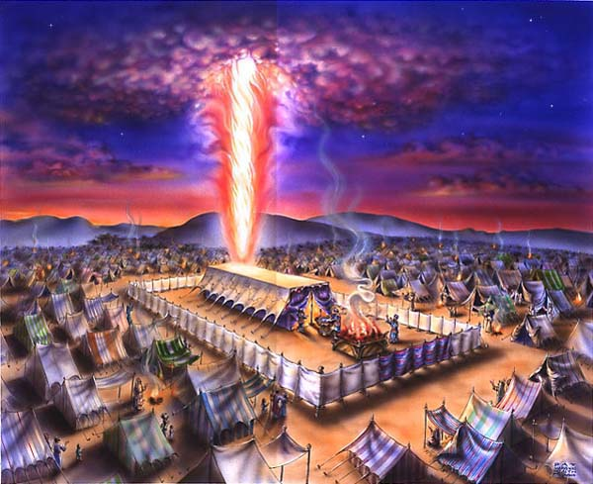

Lev 11:44 …and be holy, for I am holy...

Slide 32
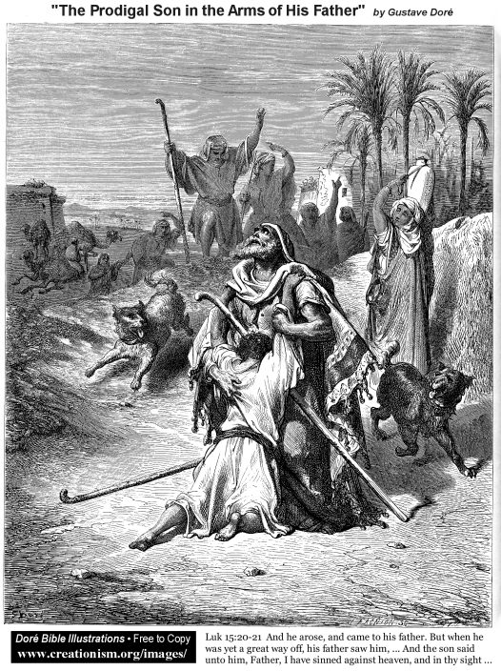
Bless the LORD, O my soul, and forget not all his benefits, who forgives all your iniquity, who heals all your diseases (Psalm 103:2-3)

Slide 33
Repentance & healing
Abimelech made compensation, so Abraham prayed that God would heal his family of barrenness (Gen. 20).
Miriam was struck with leprosy. Then she went through a period of cleansing and isolation before her healing (Num. 12:10-15)
David in Psalm 41 prayed for God to heal him from sickness. He then admitted his sins before God in hope of healing.
Job encountered God, then after his repentance, his wealth and wellbeing was restored to him (Job 42)
Jeroboam’s hand was healed after the altar was torn down and the man of God prayed for him (1 Kings 13:6)

Slide 34

祈祷
我名下的子民
我必医治他们的土地.....
历代志下 7:14

Slide 35
National Level Repentance
Moses told them to make a bronze serpent upon a pole; when they looked at it they were healed (Num. 21:9)
Phinehas killed a man who was yoked with the worship of Baal of Peor through sexual relationship with a Midianite woman, and the plague stopped (Num. 25:8)
After which they repented before the Lord averting further consequences, as of Moses in Exodus 32:31-35 and David in 2 Samuel 24:25
Hezekiah prayed for pardon for the Israelites from the North as they ate the Passover but not cleansed, God heard him and healed the people (2 Chr. 30:20)

Slide 36
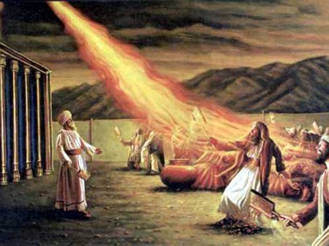
Aaron had to carry his censer to make atonement for the people. He ran in the midst of the people and stood between the living and the dead, so the plague stopped (Num. 16:41- 50).

Slide 37
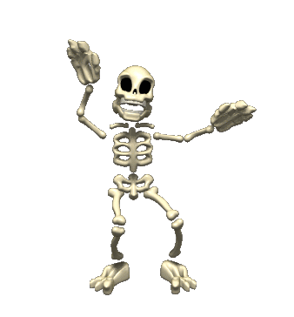
Prophecy using healing
Ezekiel – Broken Bones

Slide 38
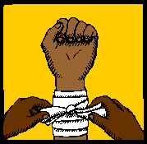
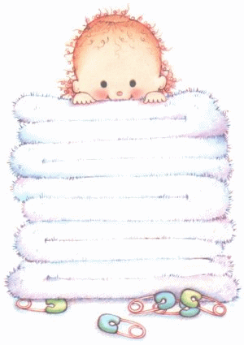
Hosea – dressing of wounds
Ezekiel – helpless newborn

Slide 39

Healing in the nations

Slide 40
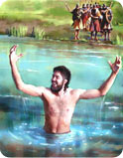
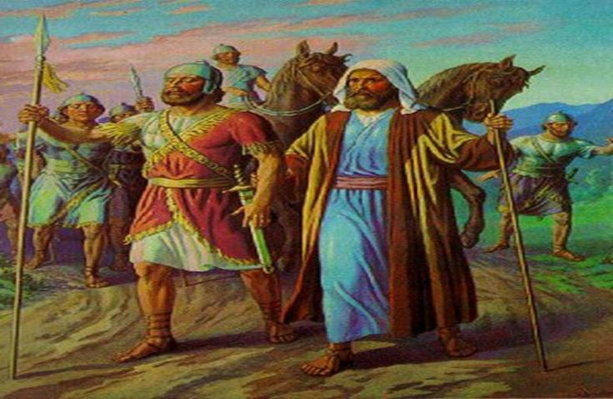
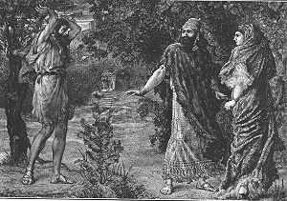
Leading the blind Syrian army
Naaman’s healing
Ben Hadad wanted to know if he would live

Slide 41
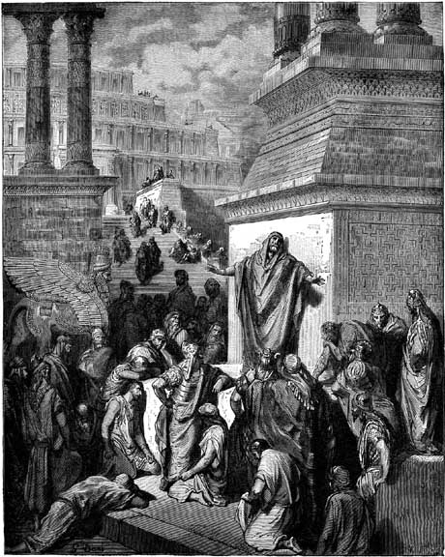
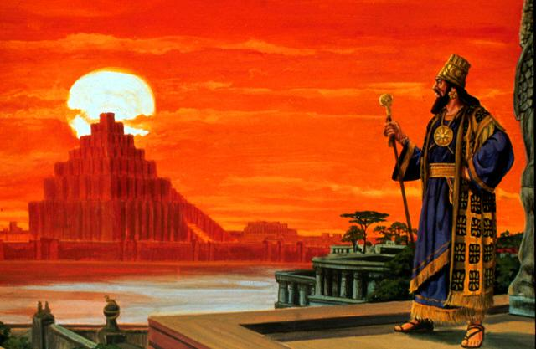
King Nebuchadnezzar
Jonah & Nineveh

Slide 42
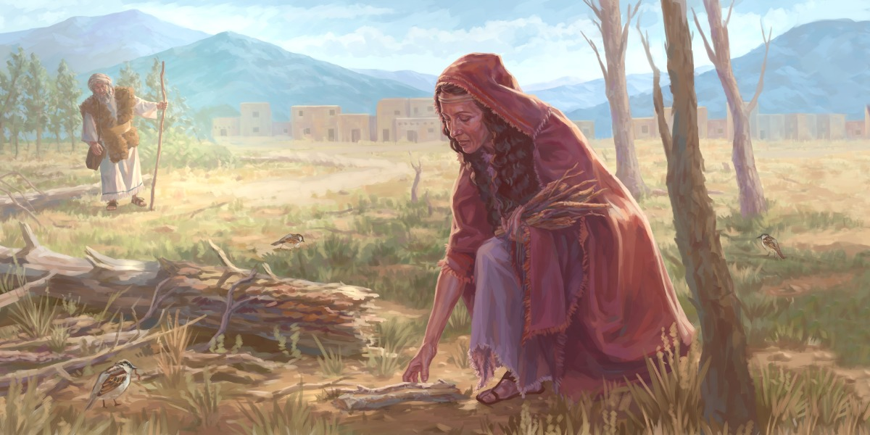
Luke 4:26-27 and Elijah was sent to none of them but only to Zarephath, in the land of Sidon, to a woman who was a widow. And there were many lepers in Israel in the time of the prophet Elisha, and none of them was cleansed, but only Naaman the Syrian.

Slide 43
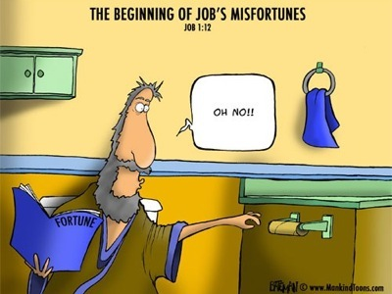
The beginning of job’s misfortunes
(Job 1:12)
Beyond judgment in sickness & healing
Oh, No!

Slide 44
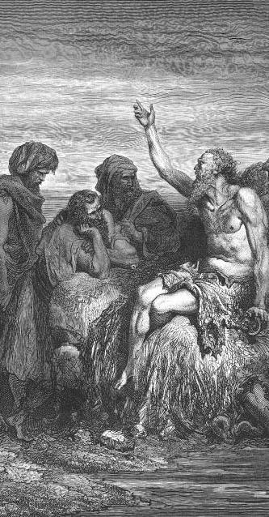
Job challenged the retribution theology by attempting to understand the reason behind the suffering of righteous man
The heart of Satan’s challenge was that man was not worthy of God’s attention
Satan’s ultimate weapon was to use sickness, thinking that men would do anything to keep themselves alive

Slide 45
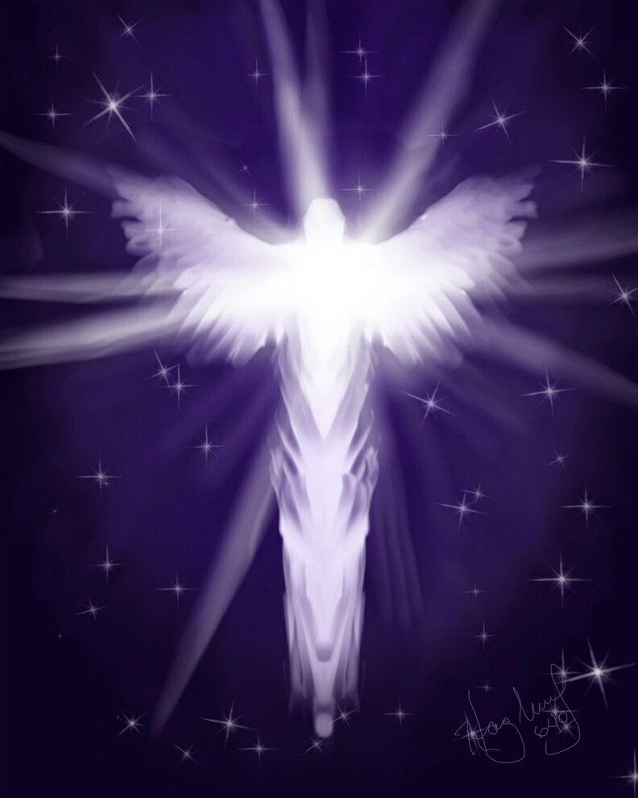
Introducing the adversary of God’s people, Satan
Job’s sufferings
Sores from the top of his head to his toes
Sores covered with worms
His skin turns black and peals, hardens and cracks
He has a fever, diarrhea, sleeplessness and constant nightmares.
Grieving the loss of his children and possessions
Bitterness of his wife towards him had caused depression to the point of suicide.
The plight of this righteous man was far from shalom peace and wellbeing.

Slide 46
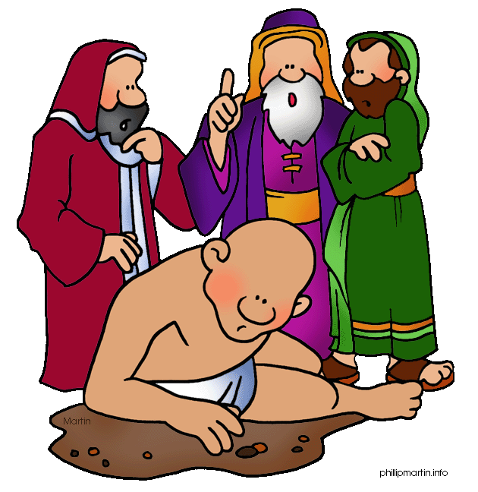
You must have sinned, so that is why God judged you. Repent and be well!
God is all powerful. He inflicted and He will heal.
How can men compare to the holiness of God? Repent!
You quack counsellors. I liked you better when you were quiet…
God is a bully. I want my lawyer… someone who stands between me and God.

Slide 47
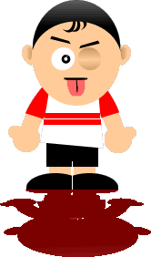
Hey brother, God does speak and He cares and wants to keep us from eternal death, using sickness if needed. We need a mediator, who understands and points you to the right direction and who is willing to pay the ransom that you might have restoration.

Slide 48

If God is all powerful and just, when He allowed righteous men to be inflicted with sickness, there must be a higher purpose.
We might not know the reason but even a greater good would come out of the sickness.

Slide 49
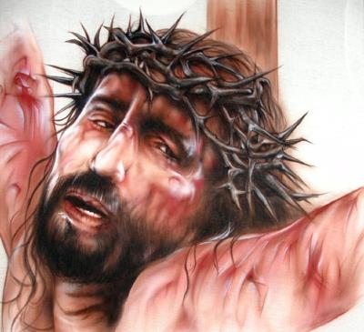
OUR Suffering servant, redeemer & healer
Jesus suffered on the cross
Sickness was because of the Fall and sin. Jesus became the guilt offering once and for all that breaks the power of sin in our lives, restoring us to shalom peace.

Slide 50
Isa 53:4-5 Surely he has borne our griefs and carried our sorrows; yet we esteemed him stricken, smitten by God, and afflicted. But he was wounded for our transgressions; he was crushed for our iniquities; upon him was the chastisement that brought us peace, and with his stripes we are healed.
Notes:
Job and Jesus are parallel in terms of innocent suffering.
_______________
OB-28-Healing-50
OS-19-Job-34
OS-23-Isaiah49-59—slide 54

Slide 51
Does Isaiah 53 speak of atonement for sin or physical healing?
Atonement for Sin | Physical Healing
Believers will face physical death but not spiritual death | Matthew 8:14-17 applies Isaiah 53:4 to physical healing
Christ came to die for our sins—not for sickness (1 Cor 15:3) | 1 Cor 15:3 refers to complete future deliverance from sin and sickness
If atonement and healing were integrated, then if we fall sick, we would doubt our salvation | Sickness closely links with effects of our fallen nature, but God forgives all our sins and heals all our diseases
Philip applied Isaiah 53 to Christ’s atonement for sin when speaking with the Ethiopian eunuch (Acts 8) | Healing and atonement of sin are not the same, yet as sins are atoned for, healing and restoration comes
Jesus quoted Isaiah 53 in Matthew 8:14-17 by using the Greek term for take away and not carried | The root word for heal in Isa 53:5 (rapha), could mean healing physically or spiritually
Peter’s quote of Isaiah 53 referred to spiritual healing | The word griefs in Isa 53:4 (choliy) is used mostly of physical healing
Notes:
Job and Jesus are parallel in terms of innocent suffering.
_______________
OB-28-Healing-51
OS-19-Job-35
OS-23-Isaiah49-59—slide 55
Adapted from a student project at Singapore Bible College

Slide 52
Job | Suffering Servant
Job is “my servant” (Job 1:8; 2:3) | God praises the Suffering Servant as he does Job (Isa 42:1)
Job is “stricken” of God (Job 19:21) | The people consider the Servant to be “stricken” of God (Isa 53:4)
Job is chastised by the Almighty (Job 5:17) | The same “chastisement” is predicted of the Servant (Isa 53:5)
Job is “despised” by compatriots (Job 19:18) | The Servant is despised and not esteemed (Isa 53:3)
Job’s friends “forget” him and his brethren “stay away” from him (Job 19:13-14) | The Suffering Servant’s compatriots “hide their faces” (Isa 53:3)
Job is “smitten” on the “cheeks” (Job 16:10) | The Servant also is “smitten” on the “cheeks” (Isa 50:6, 53:4).
Job records his experience as, “They abhor me, they flee far from me, and spare not to spit in my face” (Job 30:10, cf. Job 17:6) | The Servant does not hide his face from “spitting” (Isa 50:6 ), which is a rare word (3x) that only occurs in Job (2x) and Isaiah.
The above comparisons between Job & Suffering Servant are taken from Andrew Perry, “The Suffering Servant of Isaiah and the Suffering of Job” at http://www.christadelphian-ejbi.org/presentations/job.pdf
Notes:
Job and Jesus are parallel in terms of innocent suffering.
_______________
OB-28-Healing-52
OS-19-Job-36
OS-23-Isaiah49-59—slide 56
Adapted from a student project at Singapore Bible College

Slide 53
Job | Suffering Servant
Job claims that what has befallen him was “not for any violence” in his hands (Job 16:17) | This phrase occurs once elsewhere in Isaiah 53:9, “because he had done no violence”
Job asserts that his prayer was pure (Job 16:17) | No guile was found in the Suffering Servant’s mouth (Isa 53:9, cf. Job 31:5)
Job says that upright men are astonished or appalled at what has happened to him (Job 17:8) | “Many were appalled at thee” (Isa 52:14)
Job says that the mockers will not be “exalted” (Job 17:4) | The Suffering Servant himself is the one who would be exalted (Isa 52:13)
Job wants someone to “contend” with him ( Job 13:19) | The same question is posed by the Suffering Servant: “Who will contend with me?” (Isa 50:8)
Job complains that he is being eaten by moths (Job 13:28) | In contrast, the adversaries of the Suffering Servant would be eaten by moths (Isa 50:9)
Job rests his case with God (Job 16:19) | So does the Suffering Servant (Isa 49:4)
Notes:
Job and Jesus are parallel in terms of innocent suffering.
_______________
OB-28-Healing-53
OS-19-Job-37
OS-23-Isaiah49-59—slide 57
Adapted from a student project at Singapore Bible College

Slide 54
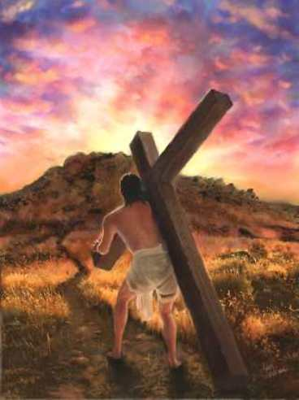
Jesus on the cross ultimately substituted for our sin of rebellion in the Fall and the sins that have been committed. His death lays the foundation for the wellness and fullness for shalom peace.

Slide 55

Satan lost his challenge
Satan used the weapon of sickness with the accusation that man will do anything to keep his life.

Slide 56
God healed Sarah of barrenness so she gave birth to Isaac, but Abraham was willing to give up Isaac because He believed that God could raise him from the dead (Heb. 11:19)

Slide 57
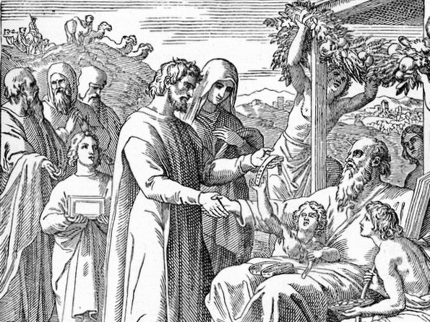
When Job had his divine encounter, he no longer pursued his restoration and healing. His suffering no longer mattered, since he knew that God’s purposes were good and higher than his sufferings.

Slide 58
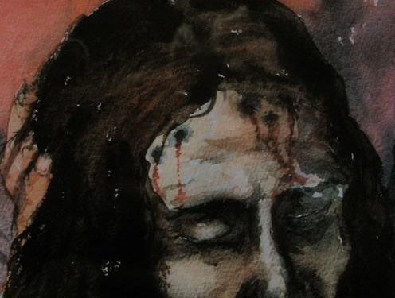
The suffering servant, Jesus, was willingly crushed and broken by God. He knew that a greater good would come out of His pain—that many would be justified because He took our place of judgment.

Slide 59
The end

Slide 60


OT Backgrounds link at BibleStudyDownloads.org
Get this presentation for free!
Notes:
NT Survey (ns)

